Slide 1

Dr. Ammar Haider
Assistant Professor
School of Computing
CS3002 Information Security
Firewalls

Slide 2
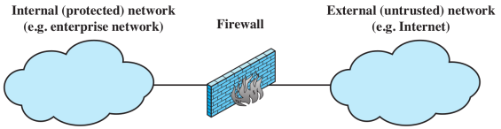
Firewalls
Internet connectivity is essential for organizations
However it creates a threat
Firewalls are effective means of protecting LANs
Protection at single point, rather on every computer within LAN
Inserted between the premises network and the Internet to establish a controlled link
Used as a perimeter defense
Single choke point to impose security and auditing
Insulates the internal systems from external networks

Slide 3
Firewall Design Goals
All traffic inside to outside and opposite, must pass through the firewall
Only authorized traffic as defined by the local security policy will be allowed to pass
The firewall itself is immune to penetration

Slide 4
Firewall Security Policies
Service control
e.g. filter based on IP address, port number
Direction control
e.g. to internal LAN, to external Internet
User control
e.g. student vs faculty
Behaviour control
e.g. filter too frequent requests, email with spam

Slide 5
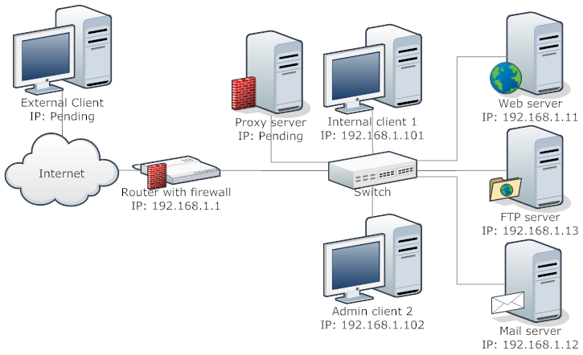
Example Firewall Jobs
Accessible to external users
Only accessible within company
Accessible to external users

Slide 6
Firewall Types
Packet Filtering: accepts/rejects packets based on L3 & L4 protocol headers
Stateful Packet Inspection: like packet filtering firewall, but considers state information (what happened previously)
Circuit-level Proxy: relay for transport layer connections
Application Proxy: relay for application traffic

Slide 7
Packet Filtering Firewall
Security policy implemented by set of rules
Rules define which packets can pass through the firewall
Firewall inspects each arriving packet (in all directions), compares against rule set, and takes action based on matching rule
Default policies: action for packets for which no rule matches
Accept (allow, forward)
Drop (reject, discard) - recommended

Slide 8
Packet Filtering Rules
Packet Information (parameters to consider)
IP address: identifies host or network
Port number: identifies applications, e.g. web (80), email (25)
Protocol number: identifies transport protocol, e.g. TCP or UDP
Direction (or firewall interface): which way packet is coming in, which way going out
Other transport, network, data link packet header fields (e.g. ICMP data types)

Slide 9
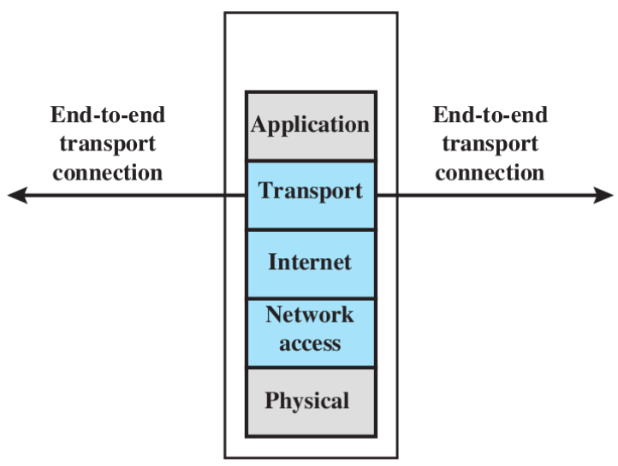
Packet Filtering Rules
Rules
Conditions defined using packet information, direction
Wildcards (*) support to match multiple values
Actions typically accept or drop
List of rules processed in order

Slide 10
Packet Filtering: Example Rules
# | Direction | Src Addr | Dest Addr | Protocol | Src Port | Dest Port | ACTION
1 | In | External | SMTP-server IP | TCP | ≥1024 | 25 | Permit
2 | Out | SMTP-server IP | External | TCP | 25 | ≥1024 | Permit
3 | Out | Internal | External | TCP | ≥1024 | 25 | Permit
4 | In | External | Internal | TCP | 25 | ≥1024 | Permit
5 | In | External | 192.168.5.7 | UDP | ≥1024 | 53 | Permit
6 | Out | 192.168.5.7 | External | UDP | 53 | ≥1024 | Permit
7 | Either | Any | Any | Any | Any | Any | DROP
SMTP server
DNS server
192.168.5.7

Slide 11
Packet Filtering: Example Rules
# | Direction | Src Addr | Dest Addr | Protocol | Src Port | Dest Port | ACTION
1 | In | External | SMTP-server IP | TCP | ≥1024 | 25 | Permit
2 | Out | SMTP-server IP | External | TCP | 25 | ≥1024 | Permit
3 | Out | Internal | External | TCP | ≥1024 | 25 | Permit
4 | In | External | Internal | TCP | 25 | ≥1024 | Permit
5 | In | External | 192.168.5.7 | UDP | ≥1024 | 53 | Permit
6 | Out | 192.168.5.7 | External | UDP | 53 | ≥1024 | Permit
7 | Either | Any | Any | Any | Any | Any | DROP
Rules 1-2: Allow incoming emails (port 25 = SMTP) and associated TCP ACKs
Rules 3-4: Allow outgoing emails and associated TCP ACKs
Rules 5-6: Allow DNS requests (inbound) and responses (outbound)
Rule 7: Default rule when no other rule matches
Reminder: port numbers 1024 and greater are used by client applications.

Slide 12
Packet Filtering Firewall
Advantages
Simplicity and speed
Transparent to users
Disadvantages
Cannot prevent attacks that employ application specific vulnerabilities or functions
Limited logging functionality
Do not support advanced user authentication
Can’t prevent attacks using IP spoofing
Improper configuration can lead to breaches

Slide 13
Stateful Packet Inspection
Traditional packet filtering firewall makes decisions based on individual packets; without considering past packets (stateless)
Many applications establish a connection between client/server; so a group of consecutive packets belong to same connection
Often easier to define rules for connections, rather than individual packets
Need to store information about past behavior (state)
Stateful Packet Inspection (SPI) is extension of traditional packet filtering firewalls
extra overhead required for maintaining state information
but faster processing of most packets

Slide 14
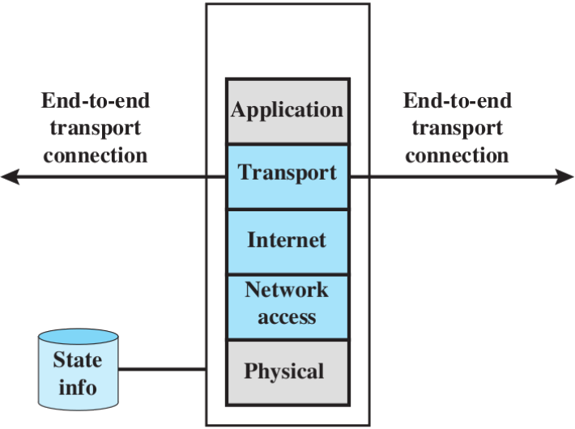
Stateful Packet Inspection
For packets accepted by packet filtering firewall, record connection information
src/dest IP address, src/dest port, sequence numbers, connection state (e.g. new, established, closing)
Packets arriving that belong to existing connections can be accepted without further processing by firewall rules

Slide 15
Stateful Packet Inspection
Simplifies the rule set by being more permissive on existing connections
# | Direction | Src Addr | Dest Addr | Protocol | Src Port | Dest Port | Connection | ACTION
1 | Either | Any | Any | TCP | Any | Any | Established | Permit
2 | In | External | SMTP-IP | TCP | ≥1024 | 25 | New | Permit
3 | Out | Internal | External | TCP | ≥1024 | 25 | New | Permit
4 | Either | Any | Any | Any | Any | Any | Any | DROP

Slide 16
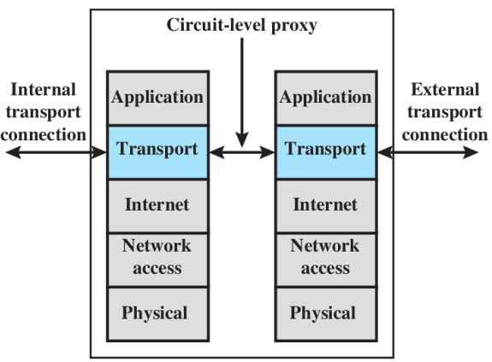
Circuit-level Proxy
Also called Circuit-level Gateway
Sets up two TCP connections, one between itself and a TCP user on an inner host and one on an outside host
For incoming data
Proxy is server to internal network clients
For outgoing data
Proxy is client sending out data to the internet
Client A
192.168.5.6
Client B
192.168.5.15
External IP
10.65.5.7
External users see this IP as source of all traffic

Slide 17
Circuit-level Proxy
Relays TCP segments from one connection to the other without examining contents
Security function consists of determining which connections will be allowed
Does not examine application layer payload
Typically used for outbound connections when inside users are trusted
Any (external) data that is requested by internal users is allowed in.
Incoming data that was never requested is blocked.

Slide 18
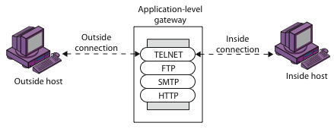
Application-level Gateway
Inspects the application level operations (e.g. HTTP response contents, email contents) and allows/denies them based on predefined rules.
Also logs attempted-access and allowed-access events
Mostly implemented as a proxy, i.e. like a circuit-level gateway it maintains separate connections
client ↔ proxy, proxy ↔ server

Slide 19
Application-level Gateway
Advantage
Much more secure than packet filters: can block packets with malicious content
Disadvantages
additional processing overhead on each connection
can become a bottleneck
breaks end-to-end encryption due to MITM like behavior

Slide 20
Firewall Location
Firewalls can be installed on hosts: end-users computers and servers
With large number of users, firewalls are placed on network devices that interconnect internal and external networks
Common to separate internal network into two zones:
Public-facing servers, e.g. web, email, DNS
End-user computers and internal servers, e.g. databases, development web servers
Public-facing servers put in De-Militarized Zone (DMZ)

Slide 21
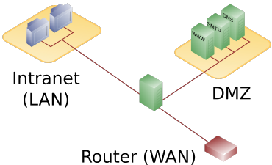
DMZ with one firewall

Slide 22
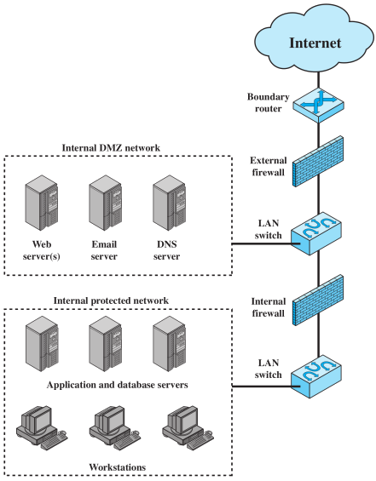
DMZ with two firewalls

Slide 23
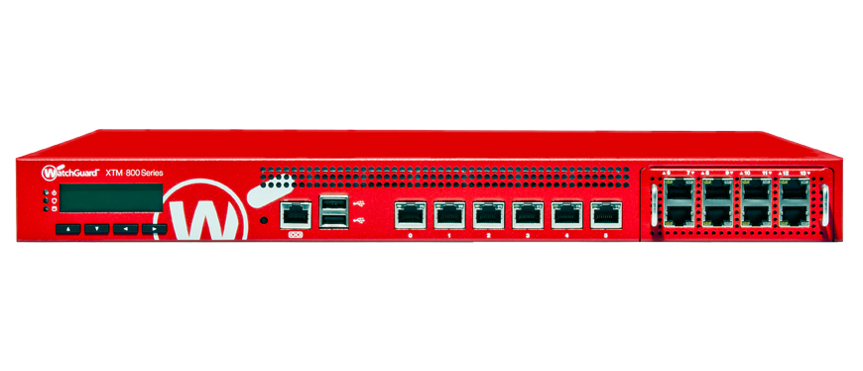
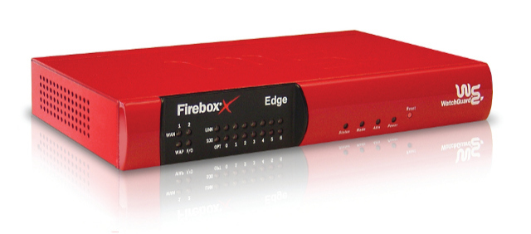
Firewall: Additional Capabilities
Normally a firewall is implemented on the gateway router. Since it is a single choke point, it can also offer additional features:
Provides a location for monitoring security events
Convenient platform for several Internet functions that are not security related, e.g. accounting, address and port translation (NAT)
Can serve as platform for VPN endpoint

Slide 24
Firewall Limitations
Cannot protect against attacks bypassing firewall
Like mobile data connections, direct connections to peer organizations
Laptop, phone, or USB drive may be infected outside the corporate network then used internally
May not protect fully against internal threats (e.g. rogue employees)
Complexity and human error: writing firewall rules that implement the security policy is difficult for large networks
Cannot inspect (encrypted) tunneled packets

Slide 25
Integrated Security Products
An organization typically needs several layers of defense, like:
Anti-malware service
Intrusion detection & prevention system
VPN server
Firewall
Anti spam
Configuring, managing and deploying several different security softwares can become a chore, not to mention performance degradation

Slide 26
Integrated Security Products
To reduce this administrative & performance burden, several vendors now supply all-in-one products.
Typically, these are called Unified Threat Management (UTM) appliances.
A UTM product will perform (at least)
network firewalling
network intrusion detection & prevention
gateway anti-virus job

Slide 27
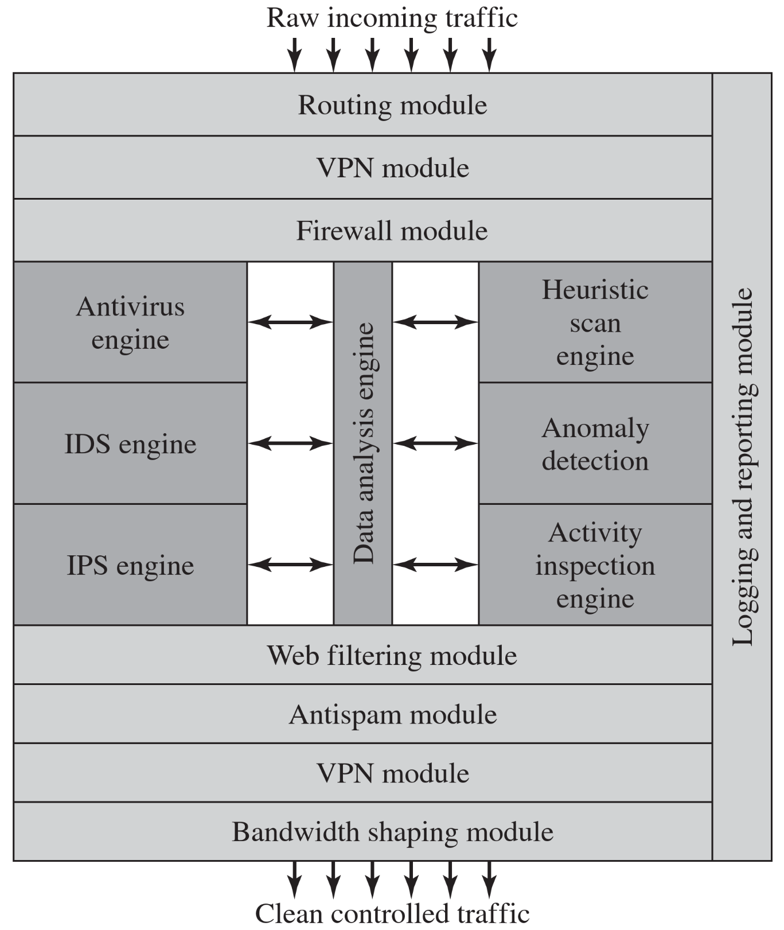
UTM Architecture

Slide 28
References
Stallings SPP chap 9

